Slide 1

Gihan Dias and
Sulochana Sooriyaarachchi
CS2032

Slide 2
Lesson Outcomes
After successful completion of this lesson you will be able to:
  Explain symbolic representation of data
  Theoretically analyze signals and transmission media

Slide 3
1. Information Representation
Bit – smallest unit of information a computer can store, 1 or 0
Code – association of combination of bits with information (character, number)
Getting all to mean same thing by same code
  Standards: ISO, IEEE
Having multiple standards
  Suit different types of data
  Suit different terminal architectures

Slide 4


ASCII
American Standard Code for Information Interchange
A 7-bit Code
  Unique combination per English keyboard character
  Both printable (letters, numbers) unprintable (control characters: line feed, tab…)
Old
M
4D 0D 0A 64 6C 4F

Slide 5


Slide 6
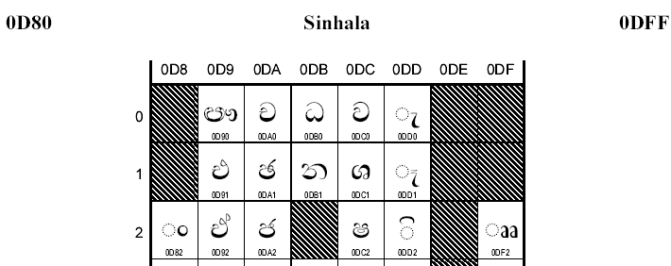
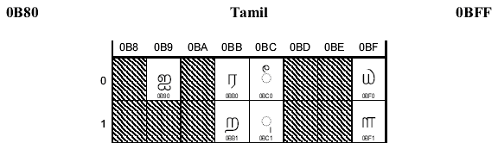
Unicode
ASCII is only a subset of Unicode
32 bit
  Unique code for symbols in different writing systems (Sinhala, Tamil, Scientific symbols…)

Slide 7
2. Signals
Used to transmit data via a medium
Media
  Copper cables, Optical Fibre, Free Space (Air)
Generated by changing the strength of a particular form of energy
Energy
  Electrical, electromagnetic, light
Dept. of Computer Science & Engineering 2007

Slide 8
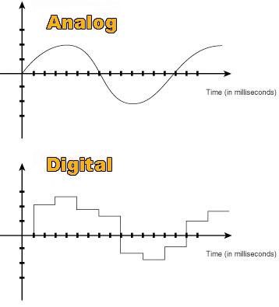
Analog Vs Digital
Analog – continuously varying and can take any value between two values any time (also called continuous time signals)
Digital – can take only a few specific values and stays at a value for a while before going to the next (discrete time signals)

Slide 9
Types of Signals
Periodic
  Repeats its wave pattern over and over
  Can be continuous or discrete
Aperiodic
  No repeating pattern
  Can be continuous or discrete
Dept. of Computer Science & Engineering 2007

Slide 10
Examples for Signals
Sine Waves
  Analog signal
  Continuous
  Periodic
Square Waves
  Digital signal
  Discrete
  Can be periodic or aperiodic
Dept. of Computer Science & Engineering - UoM

Slide 11
Sine Waves
Amplitude
a
t
F(t) = a Sin ωt
Dept. of Computer Science & Engineering 2007

Slide 12
Properties of Periodic Signals
Amplitude (A)‏
  Strength of the wave at a given time
  Measured in volts (v), amperes (A), deciBels (dB)‏
a
time
0
t₁
Dept. of Computer Science & Engineering 2007

Slide 13
Properties of Periodic Signals
Period (T)‏
  Time between two consecutive similar points in the wave
  Time taken for the pattern to repeat
time
T
T
Dept. of Computer Science & Engineering 2007

Slide 14
Properties of Periodic Signals
Frequency (f)‏
  Number of oscillations per second
  How many repetitions per unit time
  Measured in Cycles per Second or Hertz (Hz)‏
  f = 1/T e.g. 2 cycles/sec = 2 Hz
time
1
2
1 sec
Dept. of Computer Science & Engineering 2007

Slide 15
Properties of Periodic Signals
Phase
  Distance between two different waves
  In phase
  Out of phase
  aSin(ωt) and aSin(ωt + α) are out of phase by α
a
α
α
Dept. of Computer Science & Engineering 2007

Slide 16
Properties of Periodic Signals
Wavelength (λ)‏
  Physical distance between matching points of adjacent cycles of the waveform
  The signal itself does not wave back and forth along its path of travel
  We are actually measuring the distance travelled by the signal, while its electrical field goes from its maximum positive value, through zero to its maximum negative value, and then through zero again to once more reach its maximum positive value
Dept. of Computer Science & Engineering 2007

Slide 17
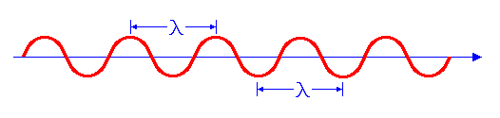
Properties of Periodic Signals
Wavelength
  c = f λ
    Where,
    c – Speed of propagation of the signal
    f – Frequency of the signal
    λ – Wavelength of the signal
distance
Dept. of Computer Science & Engineering 2007

Slide 18
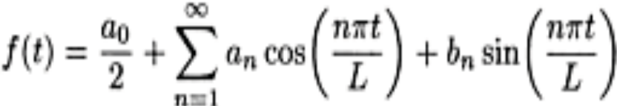
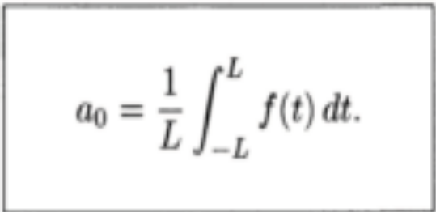
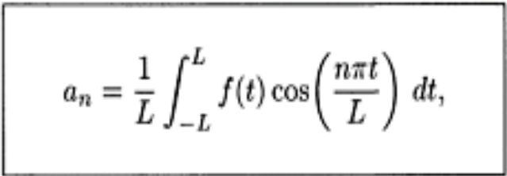
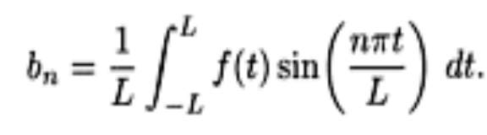
3. Communication Concepts
Fourier Series
  Jean Baptiste Fourier states that any periodic function can be expressed as a sum of sine functions of varying amplitude, frequency and phase shift. This sum is called a Fourier Series.
      2L is the period, n=0,1,2,…

Slide 19
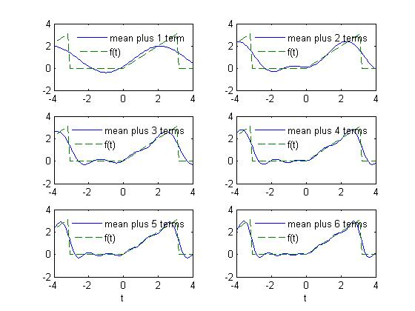
Communication Concepts
Bandwidth
  The range of frequencies that a medium is capable of handling (Measured in Hertz i.e. Hz‏)
  All media have limited bandwidth
  Transmitting a signal over a media ⬄ Approximating a signal with limited number of Fourier Series Terms
Dept. of Computer Science & Engineering 2007

Slide 20
Communication Concepts
Filtering
  Blocking certain frequencies of a signal while allowing others to pass ⬄ selecting some terms from a Fourier Series
Data Rate
  Capacity of a medium in bits per second (bps)

Slide 21



Communication Concepts
Baud Rate
  Data is divided into bit strings and each string is represented by a unique signal component at the transmitter. Baud Rate is the rate (frequency) at which the signal components change.
b1,b2,…,bn
bit string sent
signal component corresponding to bit string
b1,b2,…,bn
bit string received
Transmitter
Receiver
Transmission Medium

Slide 22
Communication Concepts
At the receiver the signals must be sampled and converted to the corresponding bit stream. Sampling should happen at at-least the same rate as the Baud Rate. Otherwise data will get lost.
Can you keep on increasing the data rate by increasing the baud rate or the number of bits in a sample?
data rate = baud rate * n

Slide 23
Communication Concepts
Nyquist Theorem
  If the highest frequency that the medium can transmit is f then a receiver is able to completely reconstruct the signal by sampling it at 2*f (if the channel is noiseless).

Slide 24

Communication Concepts
If the number of different signal components is B then,
Suppose the baud rate is 2f
Can we keep on increasing the data rate by having more signal components?
  more components ⬄ subtle difference among components
  Noise : transmitted signal can be distorted

Slide 25

Communication Concepts
Signal-to-Noise ratio (S/N)
  Ratio between the signal power and the noise power
  Measured in dB,

Slide 26

Communication Concepts
Shannon’s Theorem
  Maximum data rate of a medium is related not only to the maximum frequency the medium can handle but also to the signal-to-noise ratio as in:

Slide 27


